Slide 1
Milestone 4- Demo
(Anthony)
Dakota Taylor, Evan Walsh, Anthony Giordano, Natalie Soltis, Nick Schuler, Gyver Blessing

Slide 2
Technology Stack and Tool Chain (Natalie)
Unity (Ver. 2020.2.3f1)- Development platform for the game itself
Visual Studio or Visual Studio Code - IDE for debugging and coding
Git and Github - Version control for managing codebase
Microsoft Teams - Communication platform for meetings and project discussion
SonarQube with its SonarScanner - Code analysis program for static analysis
Unity Test Runner - Built-in test runner for unit testing

Slide 3
Individual Responsibilities (Evan)
Weapon management and animations- Dakota
Hellhound AI- Natalie
Mini Boss zombie, zombie model and animations- Anthony
Level Design- Evan
Multiplayer tentative and Level Design - Gyver
Level Design- Nick

Slide 4
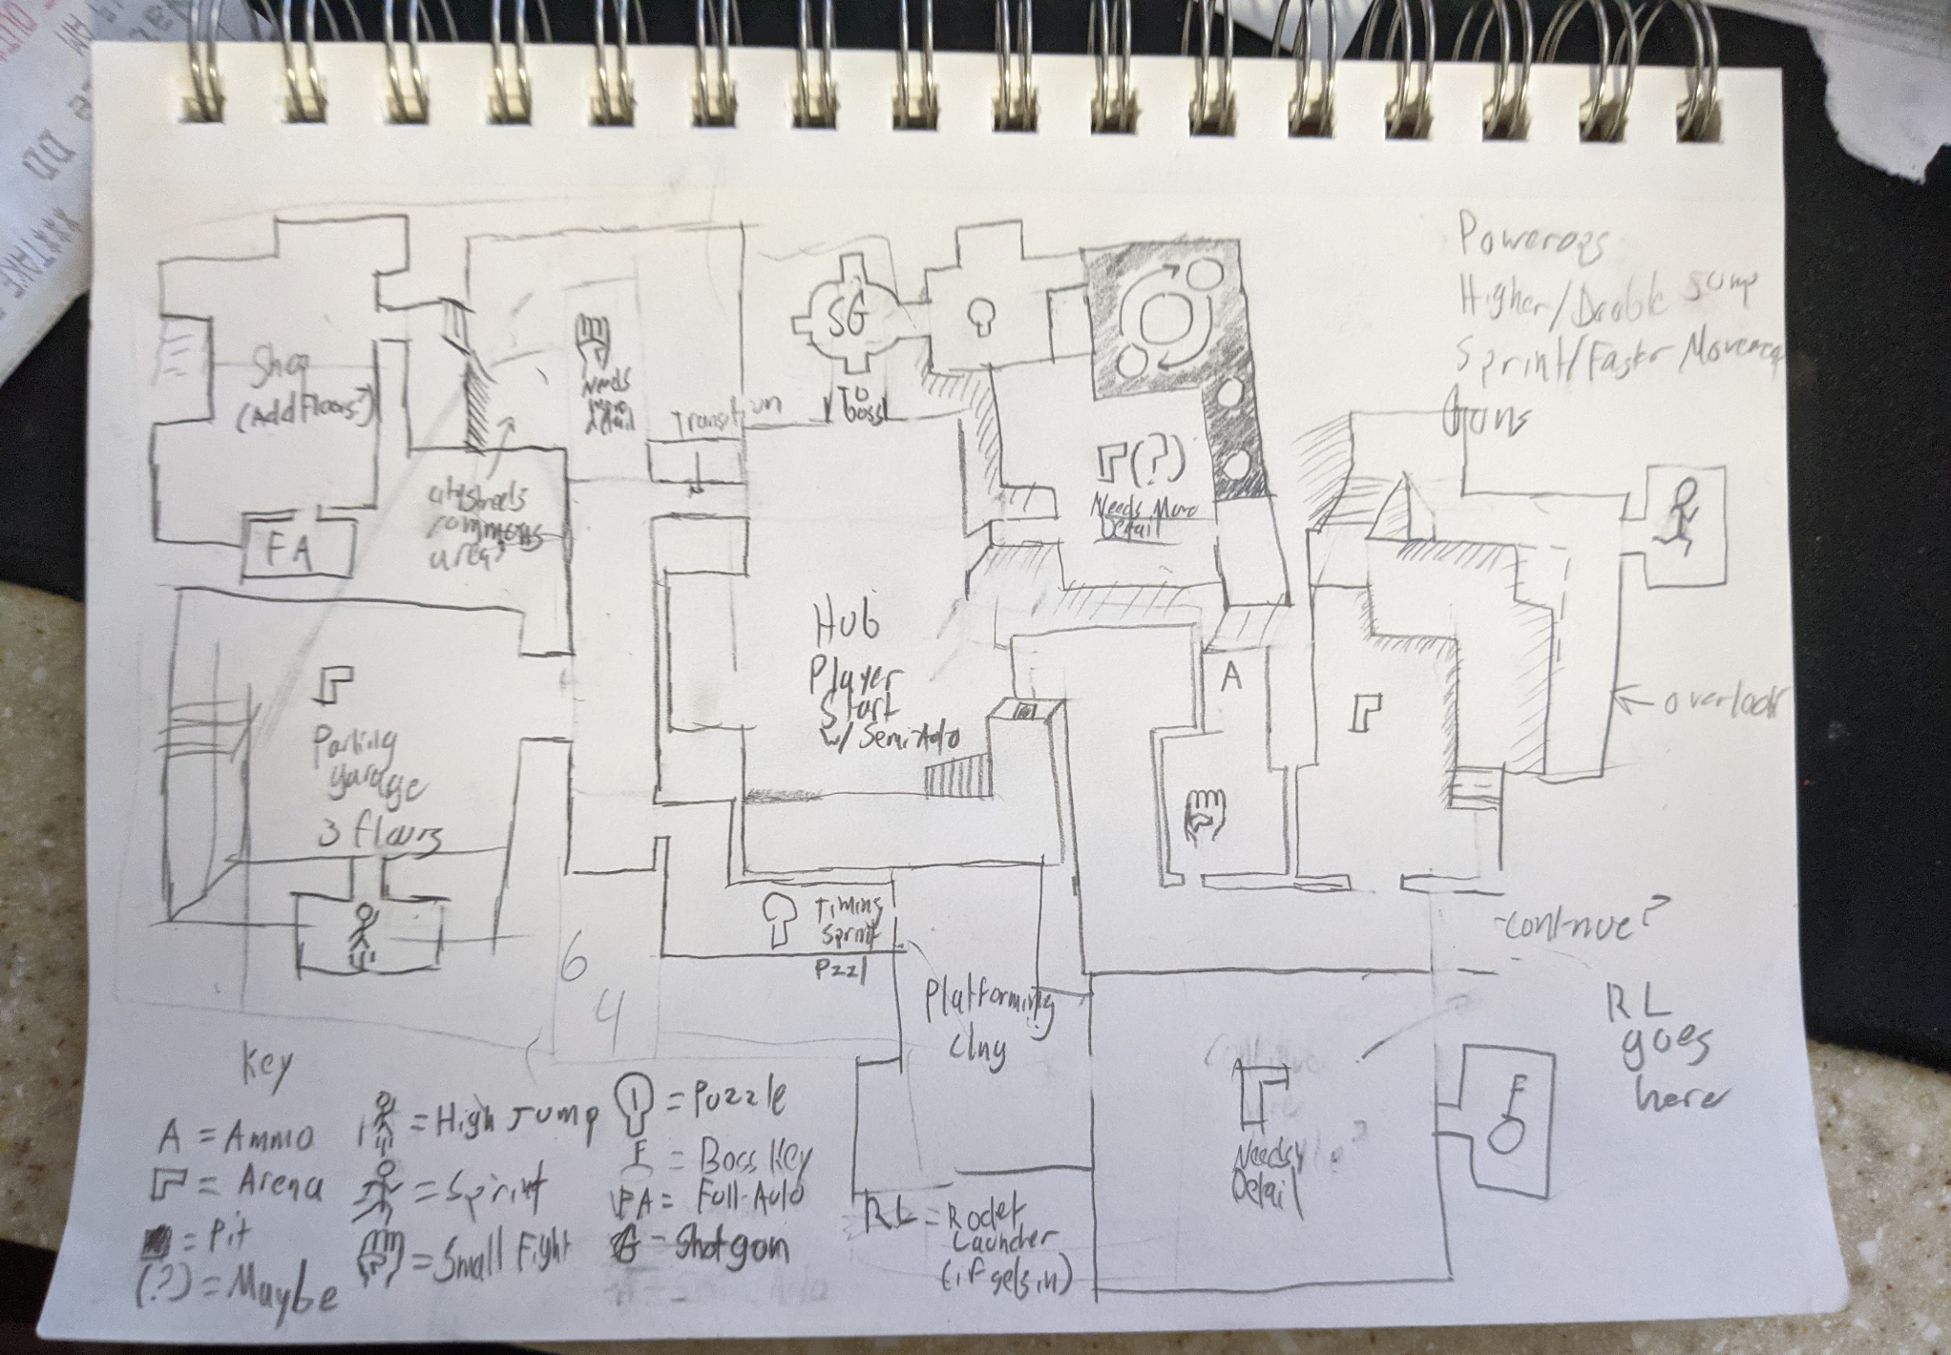
Map layout (natalie)

Slide 5
Final Milestone
By next thursday the game will be feature complete and deliverable. The project is currently being polished and being finalized. The level is nearly complete, it has to meshed together and then baked.

Slide 6
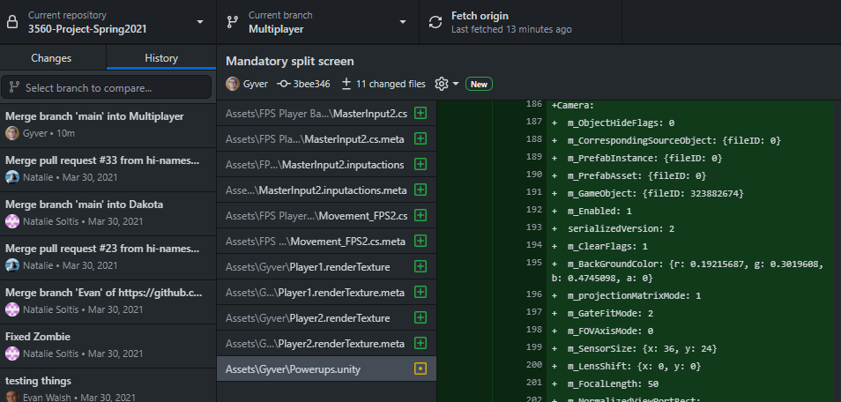
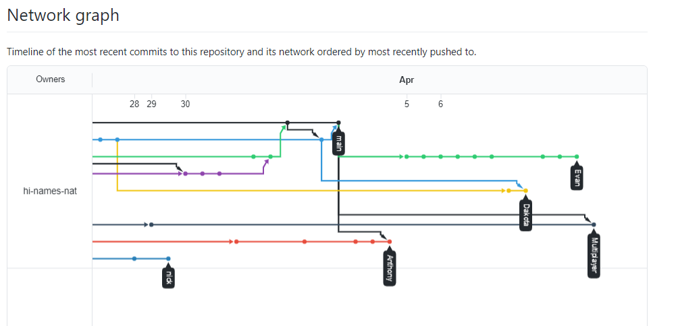
Network Graph (Gyver)

Slide 7
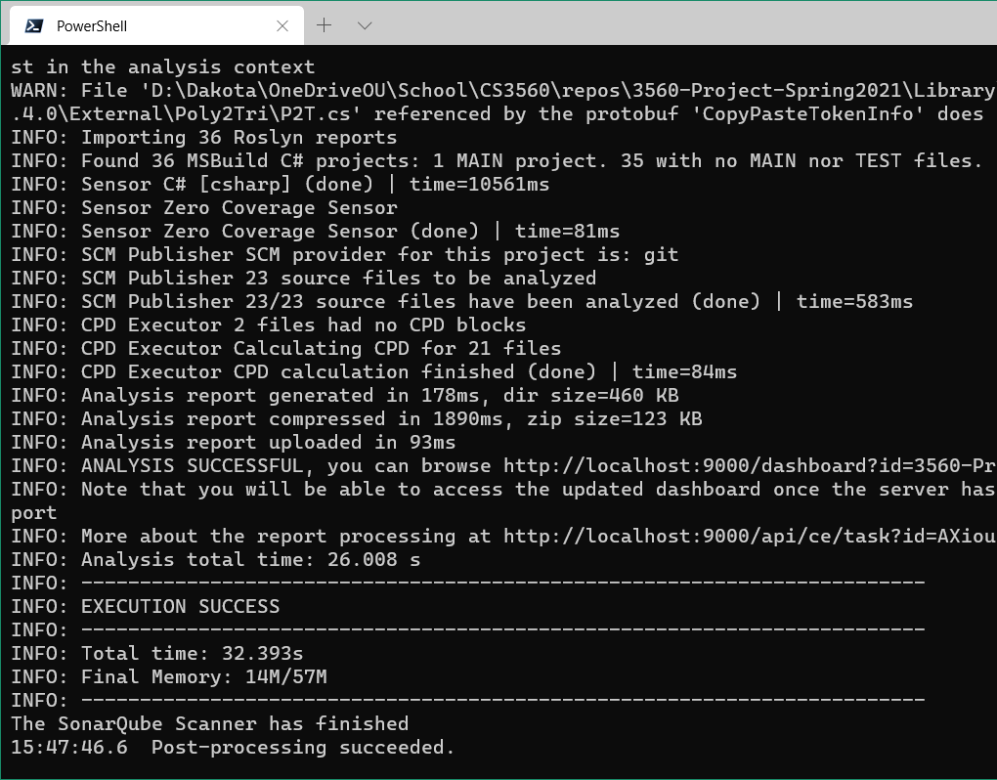
Static Analysis (Dakota)
For static analysis, we used SonarQube with its SonarScanner.
SonarQube was a software we found that works well with Unity, and it also have a nice graphical website.
We’re using the community (free) version, and are hosting it on our own machine.

Slide 8
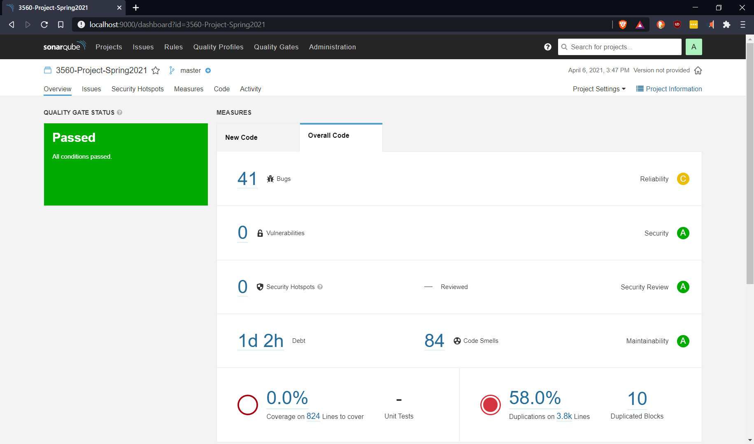
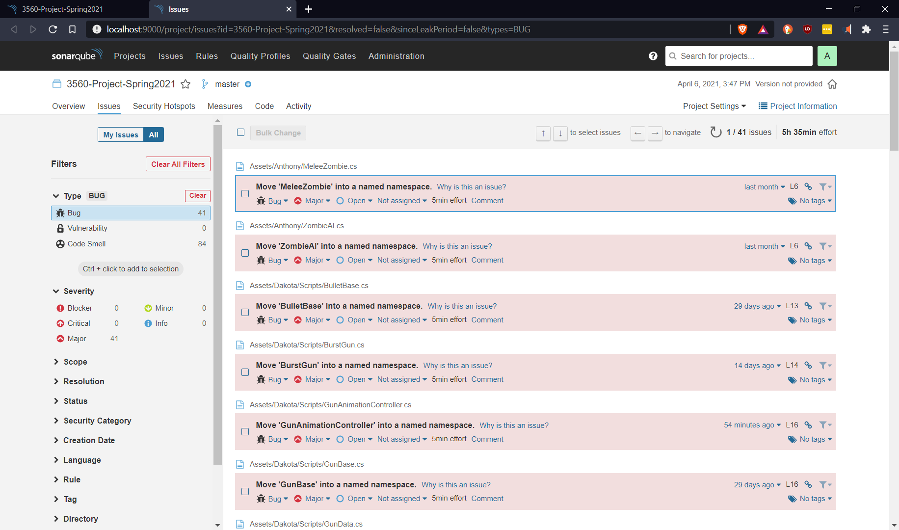

Slide 9
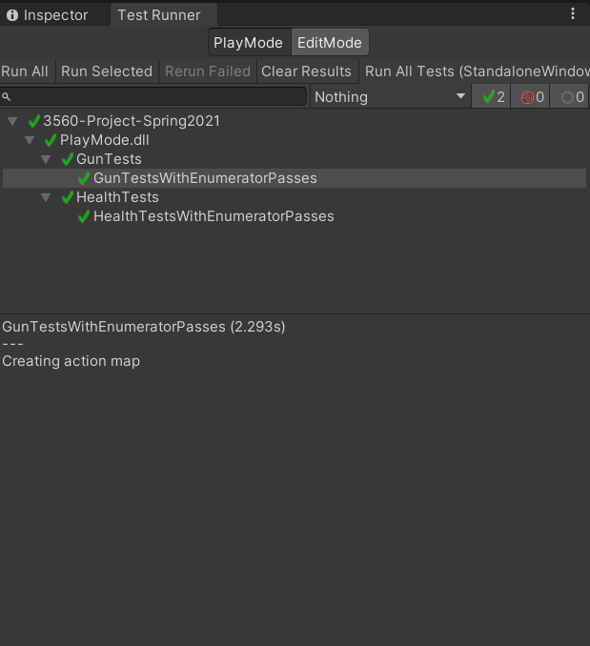
Unit Testing (Dakota)
For unit testing, we used Unity built-in unit testing system.
Although it wasn’t intuitive nor was easy to setup, it was able to function for unit testing.
In the future, we may switch to another unit testing software.

Slide 10
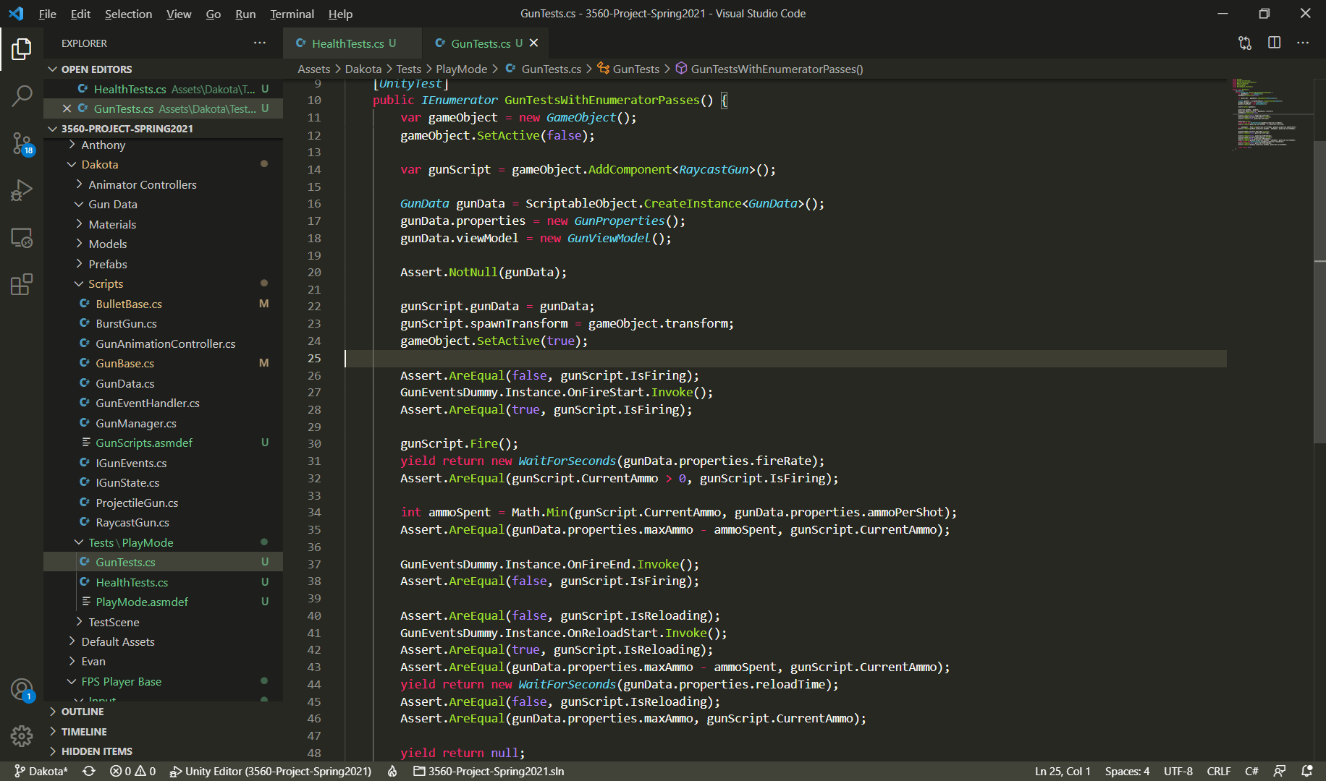
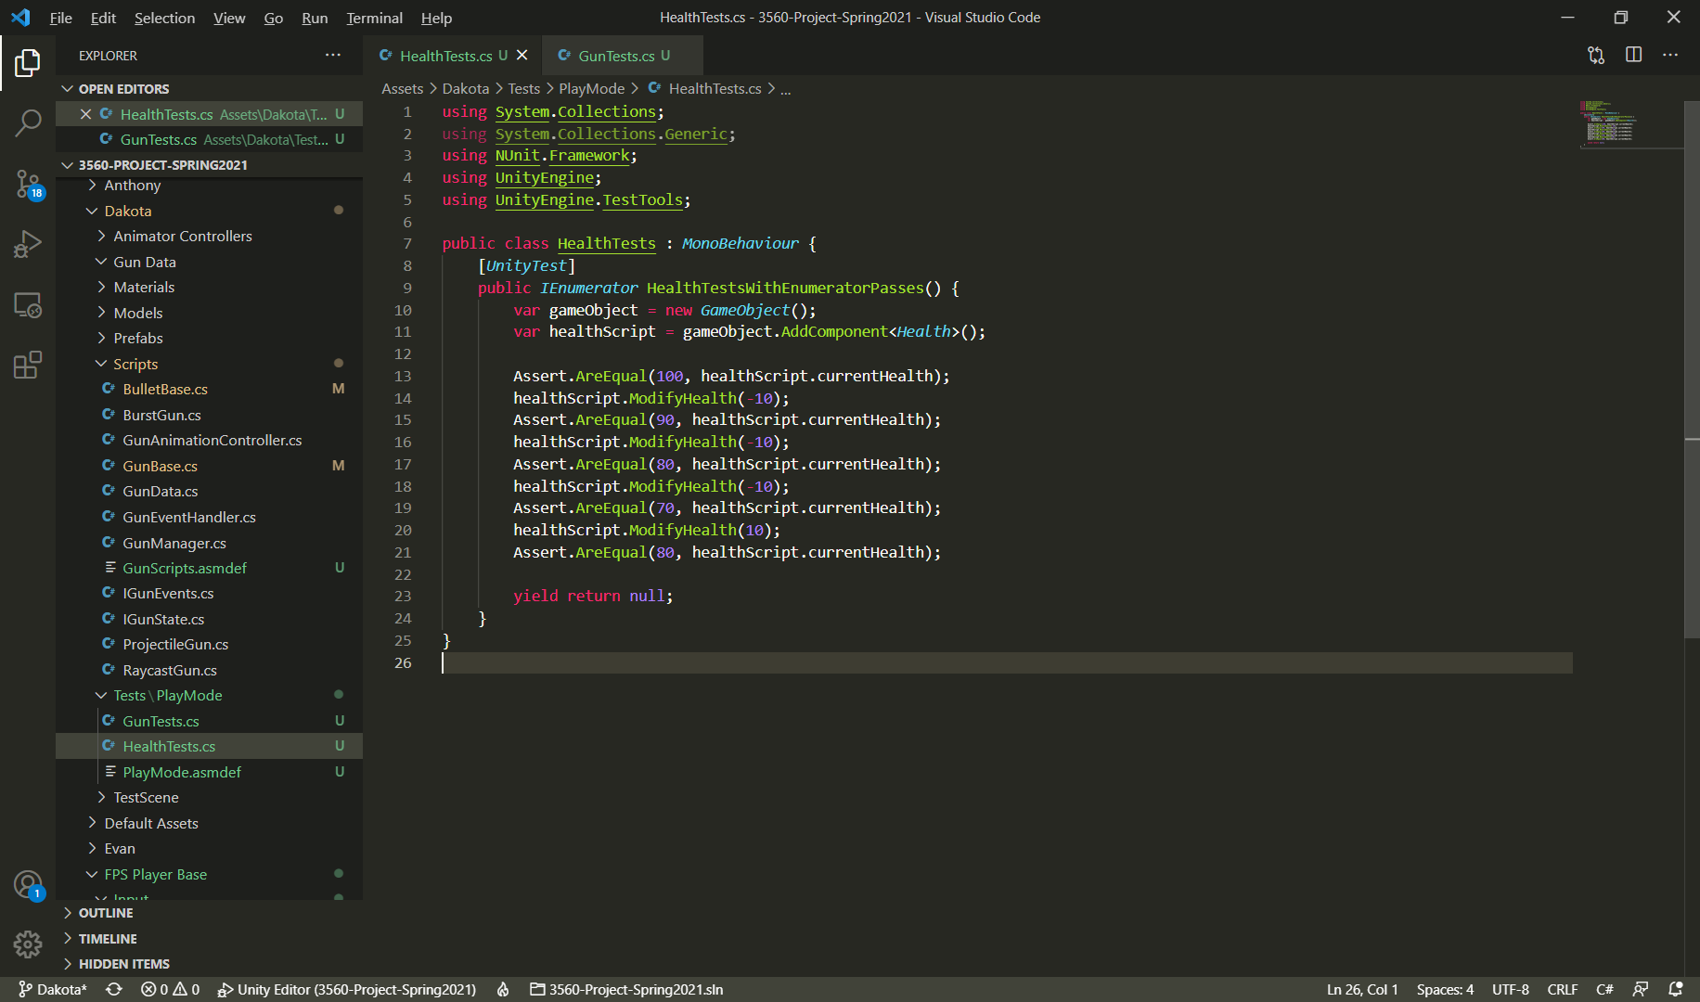

Slide 11
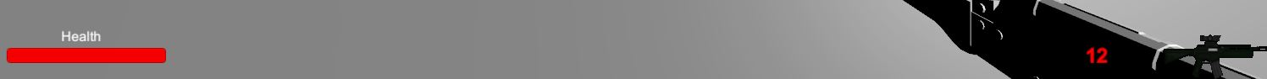
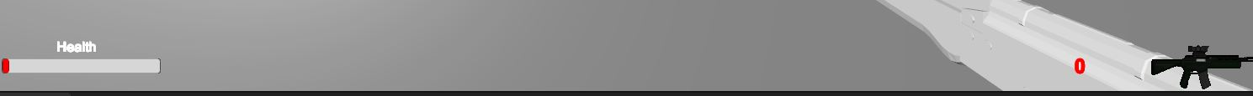
GUI Test
This is full health and the ammo counter
This is empty health and an empty ammo counter

Slide 12
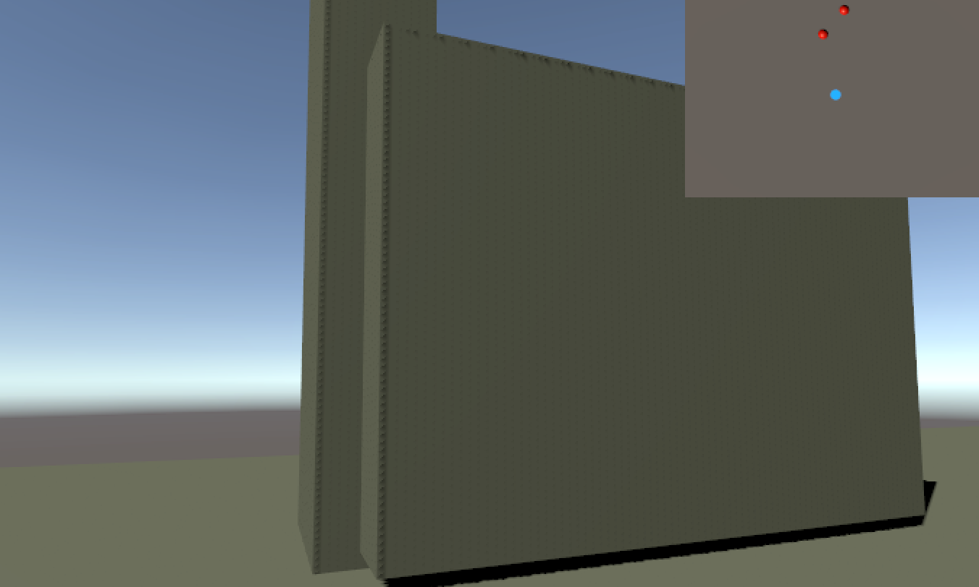

GUI testing (Evan)
This is the radar showing two enemies
This is the radar showing no enemies

Slide 13
Reflection on tool use
SonarQube - We used this tool for the static analysis and it seemed to work very well with unity.
Unity built in unit testing - It was able to work for the unit testing but it was not easy to use or set up.
Github - We used this tool to keep everything organized, it was helpful

